Slide 1
FRONT-END DEVELOPMENT
ASSIGNMENT 1 TEMPLATE
STUDENT NAME: MUKESH A
YEAR: II nd YEAR
COLLEGE CODE: 1455
COLLEGE NAME: Tagore College Of Ats And Science
DEPARTMENT: BSC Computer Science
SEMESTER: 4th
ROLL NO:unm1455222407732
NMID:93EE64DD1F454E9B2014A00FD5215EC4
DATE: 09.03.2026
PROJECT TITLE: Event Registration Form
Assignment and Assumptions:
Design and develop a simple Event Registration web page using HTML and CSS that allows users to enter details, select event preferences, and view registered participants.
1.1 Assignment:
The proposed assignment is to design and develop a Simple Event Registration Page using HTML,CSS, and JavaScript that allows users to view event details, enter personal information, select event preferences, submit registration data, and display registered participants in a table.
The web page should allow users to:
View event details
Enter personal information
Select event preferences
Submit registration details
View registered participants (static table)

Slide 2




1.2 Purpose:
The objective of this assignment is to understand the fundamentals of front-end development by creating a structured web page, designing responsive forms using CSS, and implementing basic interactivity using JavaScript.
2.Problem Statement:
This application solves the problem of manual event registration by providing an online system that efficiently collects, organizes, and displays participant details, reducing errors and saving time.
Expected Features:
3.1 Event Title and Description:
Event Name : College Workshop Registration
Description : This technical seminar is organized to enhance students’ knowledge and skills in programming through interactive sessions on Java and Python.
3.2 Event Information & Registration Form Section:
The event titled College Workshop Registration will be conducted on 15-03-2026 at Seminar Hall A and includes a registration form to collect participant details such as name, email, phone number, date of birth, gender, selected event (Java Workshop or Python Seminar), mode of participation (Online/Offline), college name, and confirmation of details before submission.
This section includes:
Event Information
Registration Form
Personal Information
Event Selection
Additional Details
Declaration
Form Controls

Slide 3



Sample:
Registration Form – Sample Filled Data Personal Information
Name: XYZ
Email: xyz@gmail.com
Phone Number: 9876543210
Date of Birth: 12/02/2006
Gender: Female
3.3. Registered Participants Section
A table is created to display the details of registered participants, including their Name, Email, Phone Number, Selected Event, and Mode of Participation, ensuring the information is clearly organized and easy to view.
| Name | Email | Phone | Event | Mode | (Add one sample row)
Sample:
Name | Email | Phone | Event | Mode
XYZ | xyz@gmail.com | 9876543210 | Web Development Workshop | Offline
3.4. Footer Section:
The footer section includes contact details such as the support email
([student@college.edu](mailto:student@college.edu)), help desk number (9444412345), support timings, and copyright information to provide assistance and official ownership details at the bottom of the page.
Sample:
Contact Email: events@abccollege.edu
Help Desk Number: +91 94444 12345
Support Timings: 9:00 AM – 4:30 PM (Working Days Only)
Copyright:© 2026 Department of Computer Science, ABC Engineering College. All Rights Reserved.

Slide 4




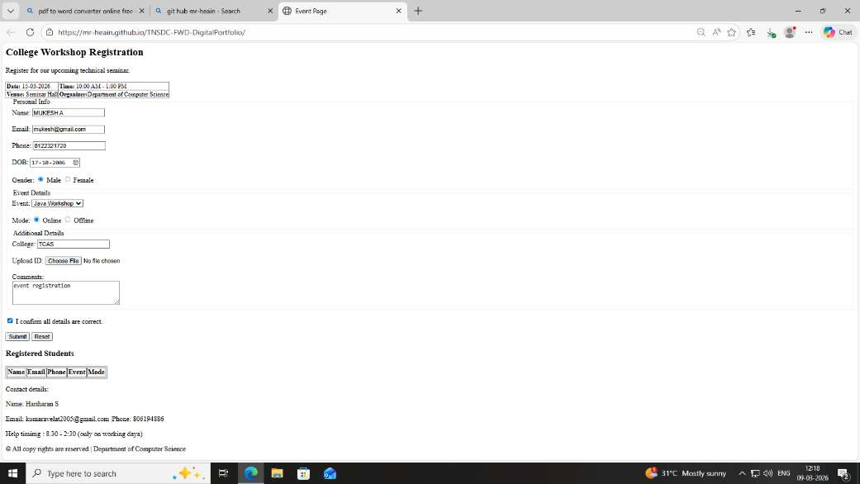
The project was developed step-by-step by first creating the basic structure using HTML, then designing and styling the layout with CSS, adding form elements and a participants table, implementing basic validation and functionality using JavaScript, and finally testing the webpage to ensure proper working and user interaction.
Implementation Steps:
The project was developed step-by-step by first creating the basic structure using HTML, then designing and styling the layout with CSS, adding form elements and a participants table, implementing basic validation and functionality using JavaScript, and finally testing the webpage to ensure proper working and user interaction.
Technologies Used:
The project was built using HTML to create the structure of the web page ,CSS to design and style the layout, form, and table elements, and JavaScript to implement form validation and basic interactivity.
Output:
Learning Outcome:
By completing this assignment, I gained practical knowledge of HTML structure, CSS styling techniques, and basic JavaScript functionality, as well as improved my understanding of form design, input validation, and creating user-friendly web interfaces.
Conclusion:
In conclusion, the Event Registration Page was successfully developed using HTML, CSS, and JavaScript, providing a simple and user-friendly interface to collect participant details, manage event registrations, and display registered participants effectively.

